Slide 1
XBMC Project – Jun, 2014 Creative Technology California Lutheran University
Kevin T. Duraj
Weijian Ji
Shu-Wei Lin
Yuanye Zeng

Slide 2

What is XBMC
XBMC is a free and open source media player developed by the XBMC Foundation

Slide 3
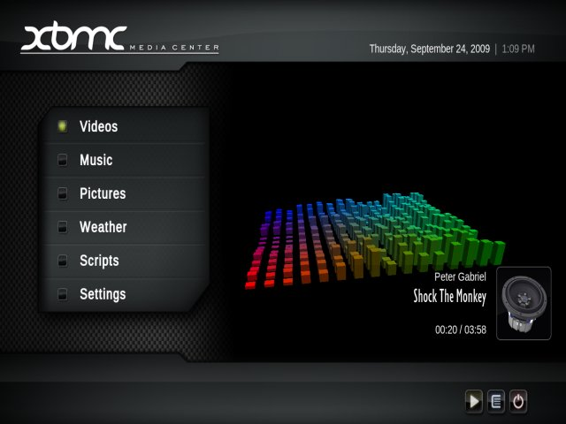
What is XBMC
It allows users to play and view most videos, music, such as podcasts from the internet, and all common digital media files from local and network storage media.

Slide 4
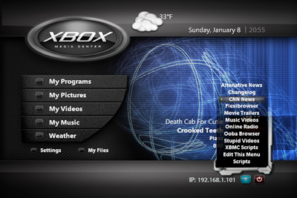
What is XBMC
The software was originally produced as a media center application named "Xbox Media Center" for the original Xbox game console.

Slide 5
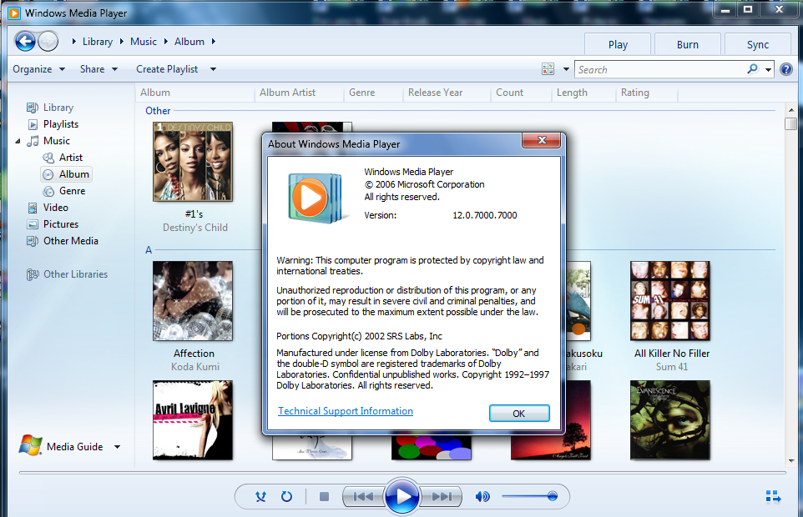
What is XBMC
It is a popular multi-platform alternative to Windows Media Center for HTPC (Home Theater PC) use.

Slide 6
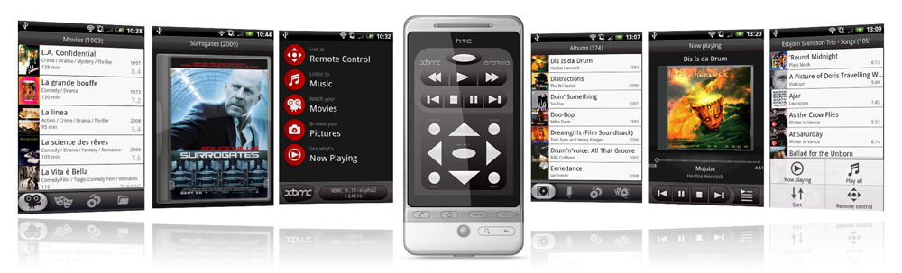
What is XBMC
It was later made available under the name "XBMC" as a native application for Android, Linux, BSD, Mac OS X, iOS, and Microsoft Windows operating systems.

Slide 7
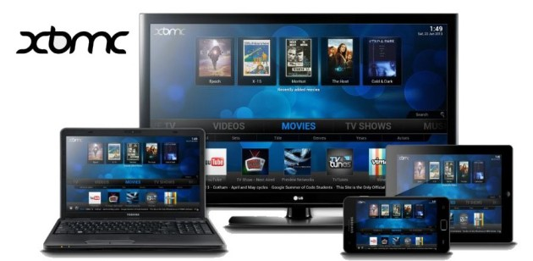
What is XBMC
Because of its open source and cross-platform nature, with its core code written in C++ (ANSI standard), modified versions of XBMC together with a JeOS have been used as a software appliance suite in a variety of devices including smart TVs, set-top boxes, digital signage, hotel television systems, and network connected media players.

Slide 8
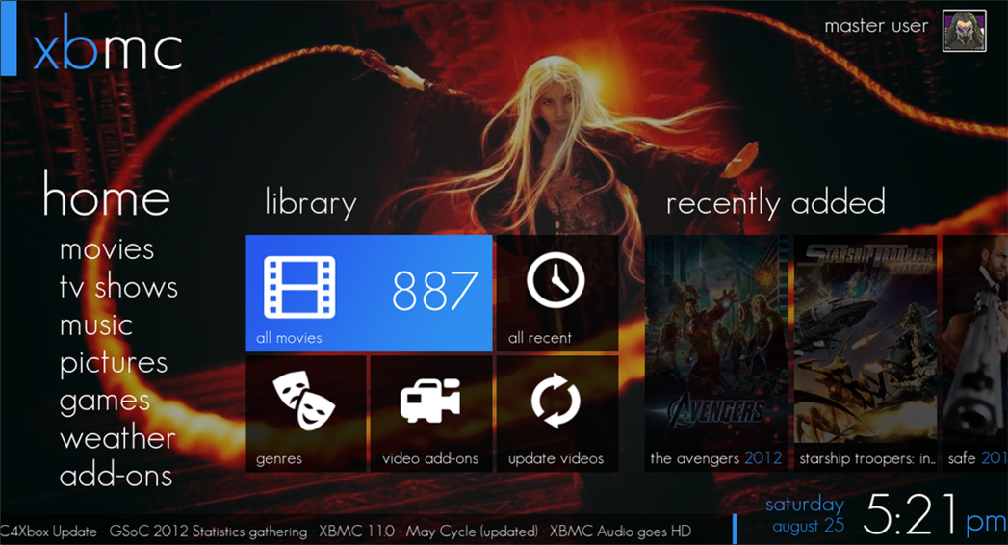
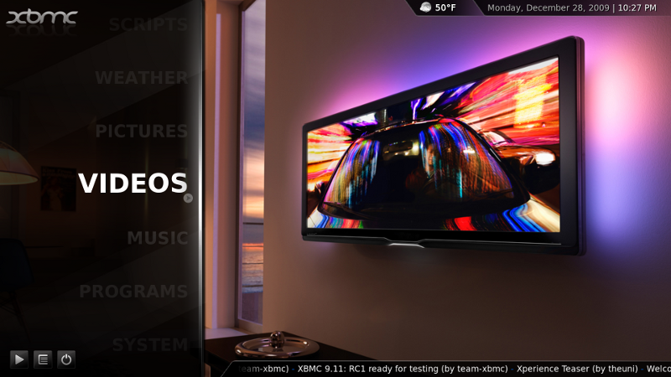
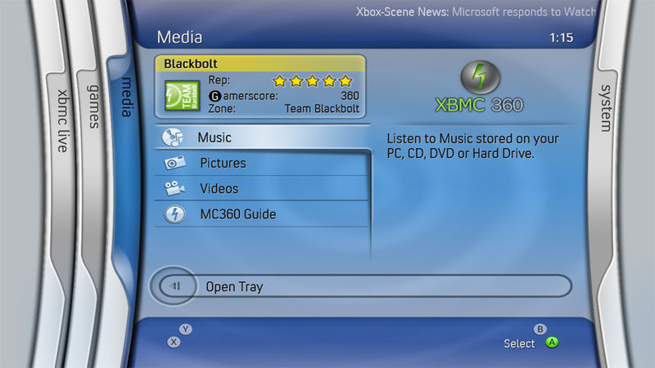
What is XBMC
XBMC is highly customizable: a variety of skins can change its appearance, and various plug-ins allow users to access online content on services such as YouTube, Spotify, Grooveshark and Pandora Radio.

Slide 9
What are the add-on’s?
Add-ons are packages that add features and functions not normally included with XBMC.
Add-ons are developed by people on Team XBMC and third-parties.

Slide 10
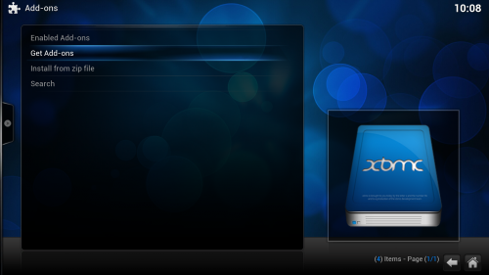
How to install add-ons?
Step 1: Select Get Add-ons

Slide 11
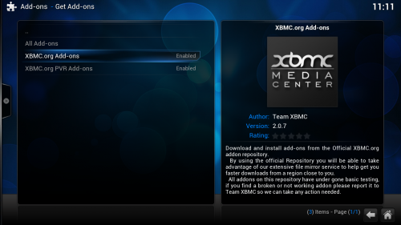
How to install add-ons?
Step 2: Select the repository you want to install from.

Slide 12
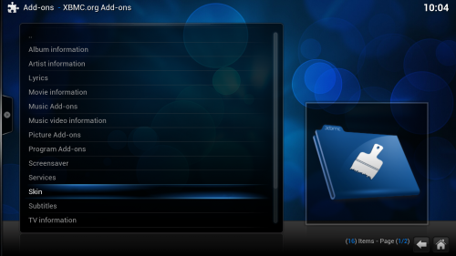
How to install add-ons?
Step 3: Select the add-on category, in this case Skin.

Slide 13
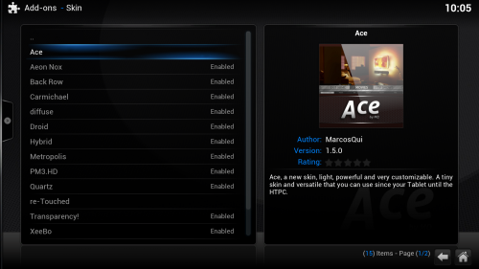
How to install add-ons?
Step 4: Select the add-on you want to install, in this case the skin Ace.

Slide 14
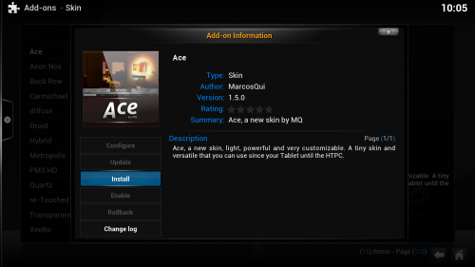
How to install add-ons?
Step 5: A summary dialog will be brought up allowing you to see various properties of the add-on. Select Install to begin automatic downloading and installation.

Slide 15
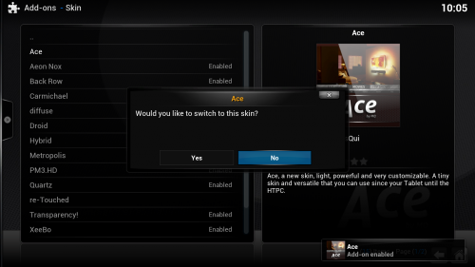
How to install add-ons?
Step 6: In the case of skin installation you'll be asked if you want to change to the installed skin immediately.

Slide 16
How to install add-ons?
When the add-on has finished downloading XBMC will enable it and depending on the add-on ask if you want to start using it. Add-ons will then appear in their appropriate section

Slide 17
Some add-ons I like…
There are more than 600 hundred add-ons, I will share with you some add-ons I like.
http://wiki.xbmc.org/index.php?title=Category:All_add-ons&pageuntil=GoldPageMedia%0AGoldPageMedia#mw-pages

Slide 18
Add-on:ESPN Video
ESPN.com is the leading provider of sports on the Internet. ESPN.com provides its users, the young, affluent, male sports fan, with late breaking news, statistics, schedules, and player updates, in addition to up-to-the minute sports scores from live events.

Slide 19
Add-on:NBA Video
Watch the latest basketball news and highlights from NBA.com

Slide 20
Add-on:Apple iTunes Podcast Add-on:Apple iTunes Podcasts
This add-on lets you browse and search for thousands of free Podcasts. NO iTunes Required! It provides both, audio and video podcasts - each devided into over 60 genres. You can also search for specific podcasts by name. It is also possible to manage a "My Podcasts" list via context-menu.

Slide 21
Add-on:Comic Vine
Comic Vine is the world's largest comic book website. Watch hundreds of original videos and interviews with comic creators and artists.

Slide 22
Add-on:Facebook Media
Browse your and your friends' photos and videos. View and add comments and likes. View image tags.

Slide 23
Add-on:TED Talks
TED is a small nonprofit devoted to Ideas Worth Spreading. It started out (in 1984) as a conference bringing together people from three worlds: Technology, Entertainment, Design. Since then its scope has become ever broader.

Slide 24
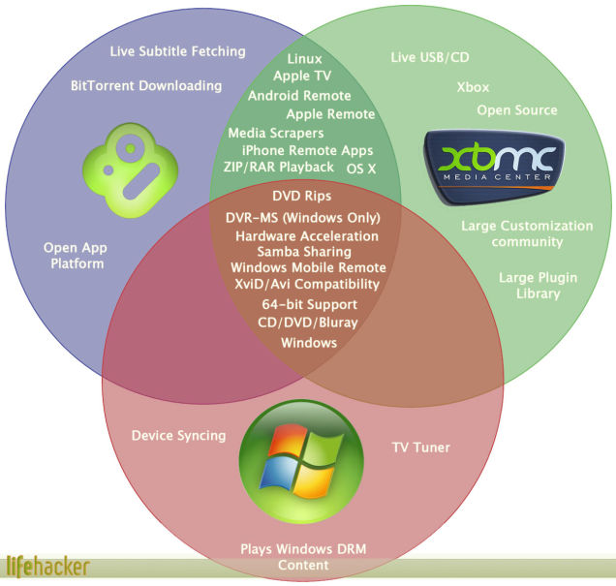
competitors
Most popular media center:
XBMC
BOXEE
Windows Media Center

Slide 25

My choice: VLC Media Player
VLC is a free and open source cross-platform multimedia player and framework that plays most multimedia files as well as DVDs, Audio CDs, VCDs, and various streaming protocols.

Slide 26
VLC Media Player
Features
Simple, fast and powerful media player.
Plays everything: Files, Discs, Webcams, Devices and Streams.
Plays most codecs with no codec packs needed:
MPEG-2, DivX, H.264, MKV, WebM, WMV, MP3...
Runs on all platforms: Windows, Linux, Mac OS X, Unix...
Completely Free, no spyware, no ads and no user tracking.
Can do media conversion and streaming.
Sources
User can also directly get the source code.

Slide 27
Reference
http://wiki.xbmc.org/index.php?title=Category:All_add-ons&pageuntil=GoldPageMedia%0AGoldPageMedia#mw-pages
"Add mips arch". Github.com. 30 September 2011. Retrieved 17 October 2011.
http://lifehacker.com/5462275/which-media-center-is-right-for-you-boxee-xbmc-and-windows-media-center-compared

